Slide 1
Bài giảng điện tử
Unit 1: Towns and Cities
Lesson 2: Reading

Slide 2
Crosswords

Slide 3
H
O
T
E
L
R
E
S
T
A
U
R
A
N
T
L
I
B
R
A
R
Y
S
P
O
R
T
S
C
E
N
T
R
E
SHIP
This is a place where people can eat and drink.
People usually stay in this place when they are on vacation
Place where you play sports.
Where people can borrow and read books.

Slide 4
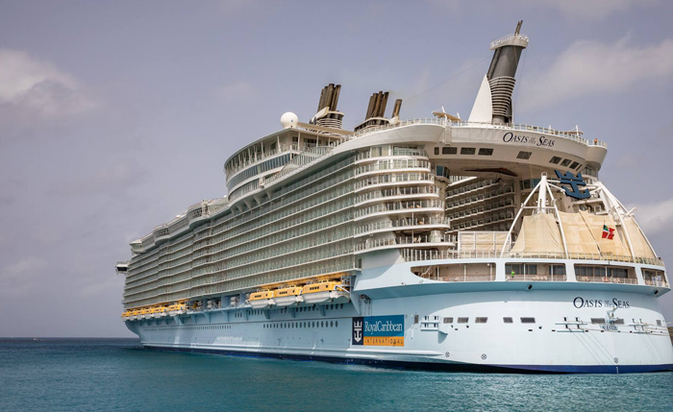
CRUISE SHIP

Slide 5
UNIT 1
TOWNS AND CITIES
LESSON 2: READING

Slide 6
Guessing game

Slide 7
TRUE - FALSE QUIZ
a) There is a library and a school on the ship.
b) There are some swimming pools on the ship.
c) There is one café and one restaurant on the ship.

Slide 8
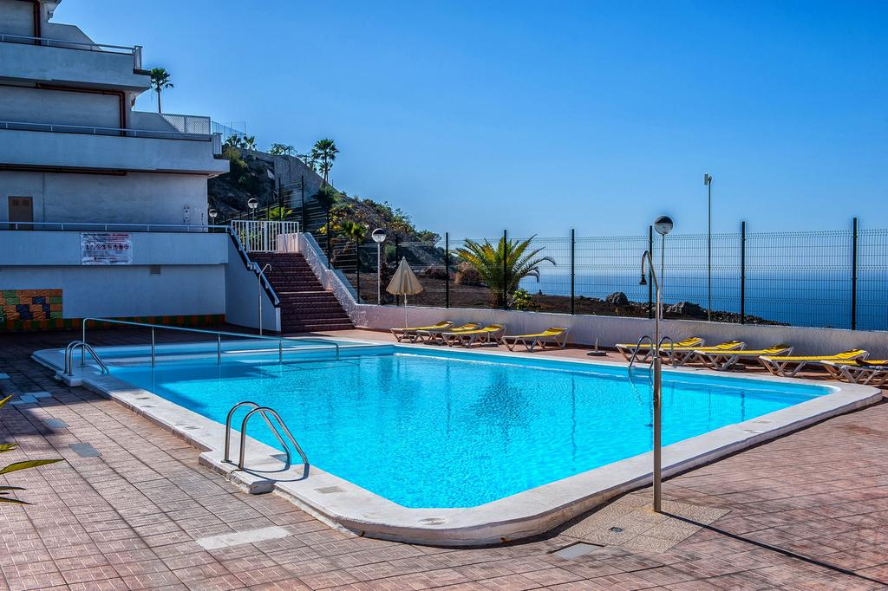
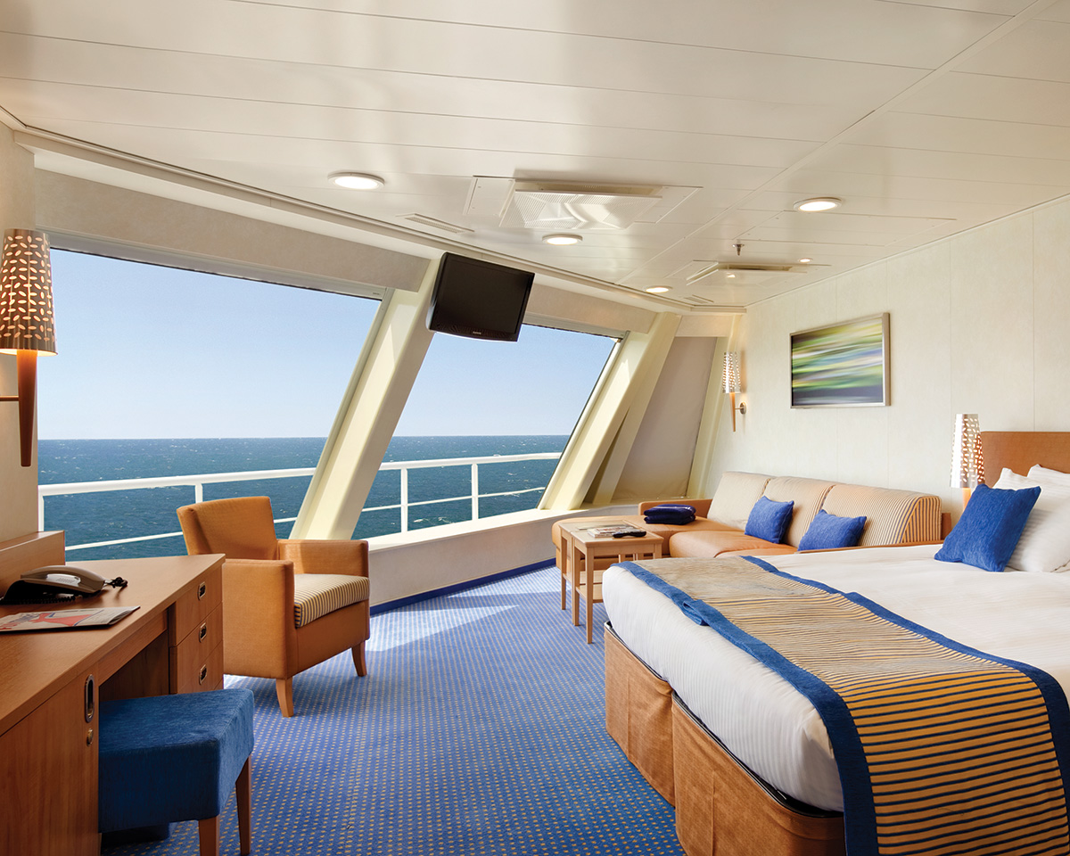
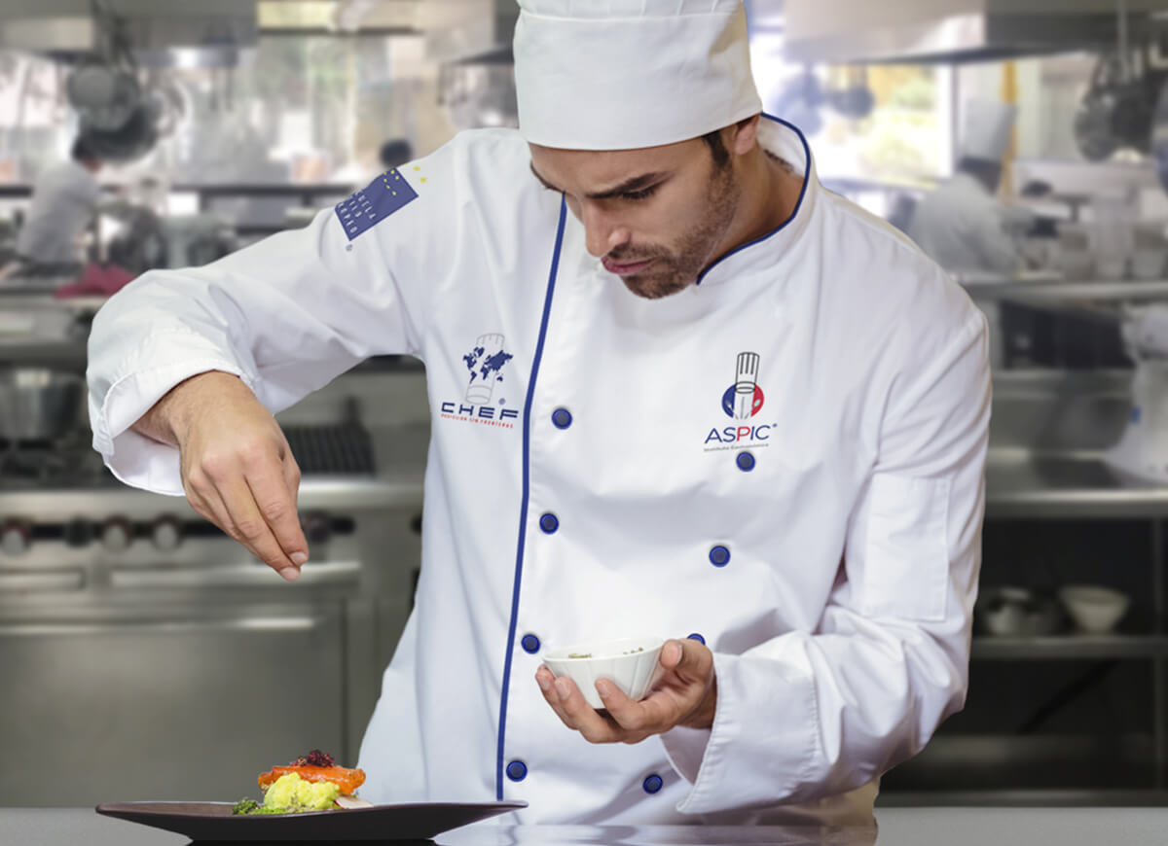
Vocabulary:
- cruise ship (n)
- fantastic (a)
E.g: This is a fantastic hotel.
- comfortable (a)
E.g: This soft bed is very comfortable.
- cabin (n)
- passenger (n)
E.g: There are many passengers on the ship.
- chef (n)
- swimming pool (n)
- climbing wall (n)

Slide 9
How many chefs are there on the ship?

Slide 10
Skill strategy
How to answer specific questions about the text?
- First, identify the key word in the question.
- Next, scan the text for the key word.
- Finally, you can find the correct answer in the sentence that has key word.

Slide 11
Listen and underline what numbers refer to.
a) 6,360
the number of passengers
b) 20
the number of café and restaurants
c) 50
the number of real trees on the ship
d) 12,000
the number of plants on the ship

Slide 12
Comprehension questions
1. What is the name of the ship?
2. How many people work on the ship?
3. How many chefs are there on the ship?
4. Is it the only ship with a park?
5. What’s in the sports area?

Slide 13
Comprehension questions
1. What is the name of the ship?
It’s Oasis of the Seas.
2. How many people work on the ship?
There are more than 2,000 people work on the ship.
3. How many chefs are there on the ship?
There are 250 chefs.
4. Is it the only ship with a park?
Yes, it is.
5. What’s in the sports area?
There’s a climbing wall in the sports area.

Slide 14
TRUE - FALSE QUIZ
a) There is a library and a school on the ship.
F
T
b) There are some swimming pools on the ship.
T
c) There is one café and one restaurant on the ship.

Slide 15
GROUP DISCUSSION

Slide 16
“Is the Oasis of the Seas a good place for a holiday? Why/ Why not?”

Slide 17
Homework
Prepare next lesson – Language focus.
+ Definite and zero article.
+ Is there…?, Are there …?, How many….?

Slide 18
www.phuongnam.edu.vn

